Slide 1


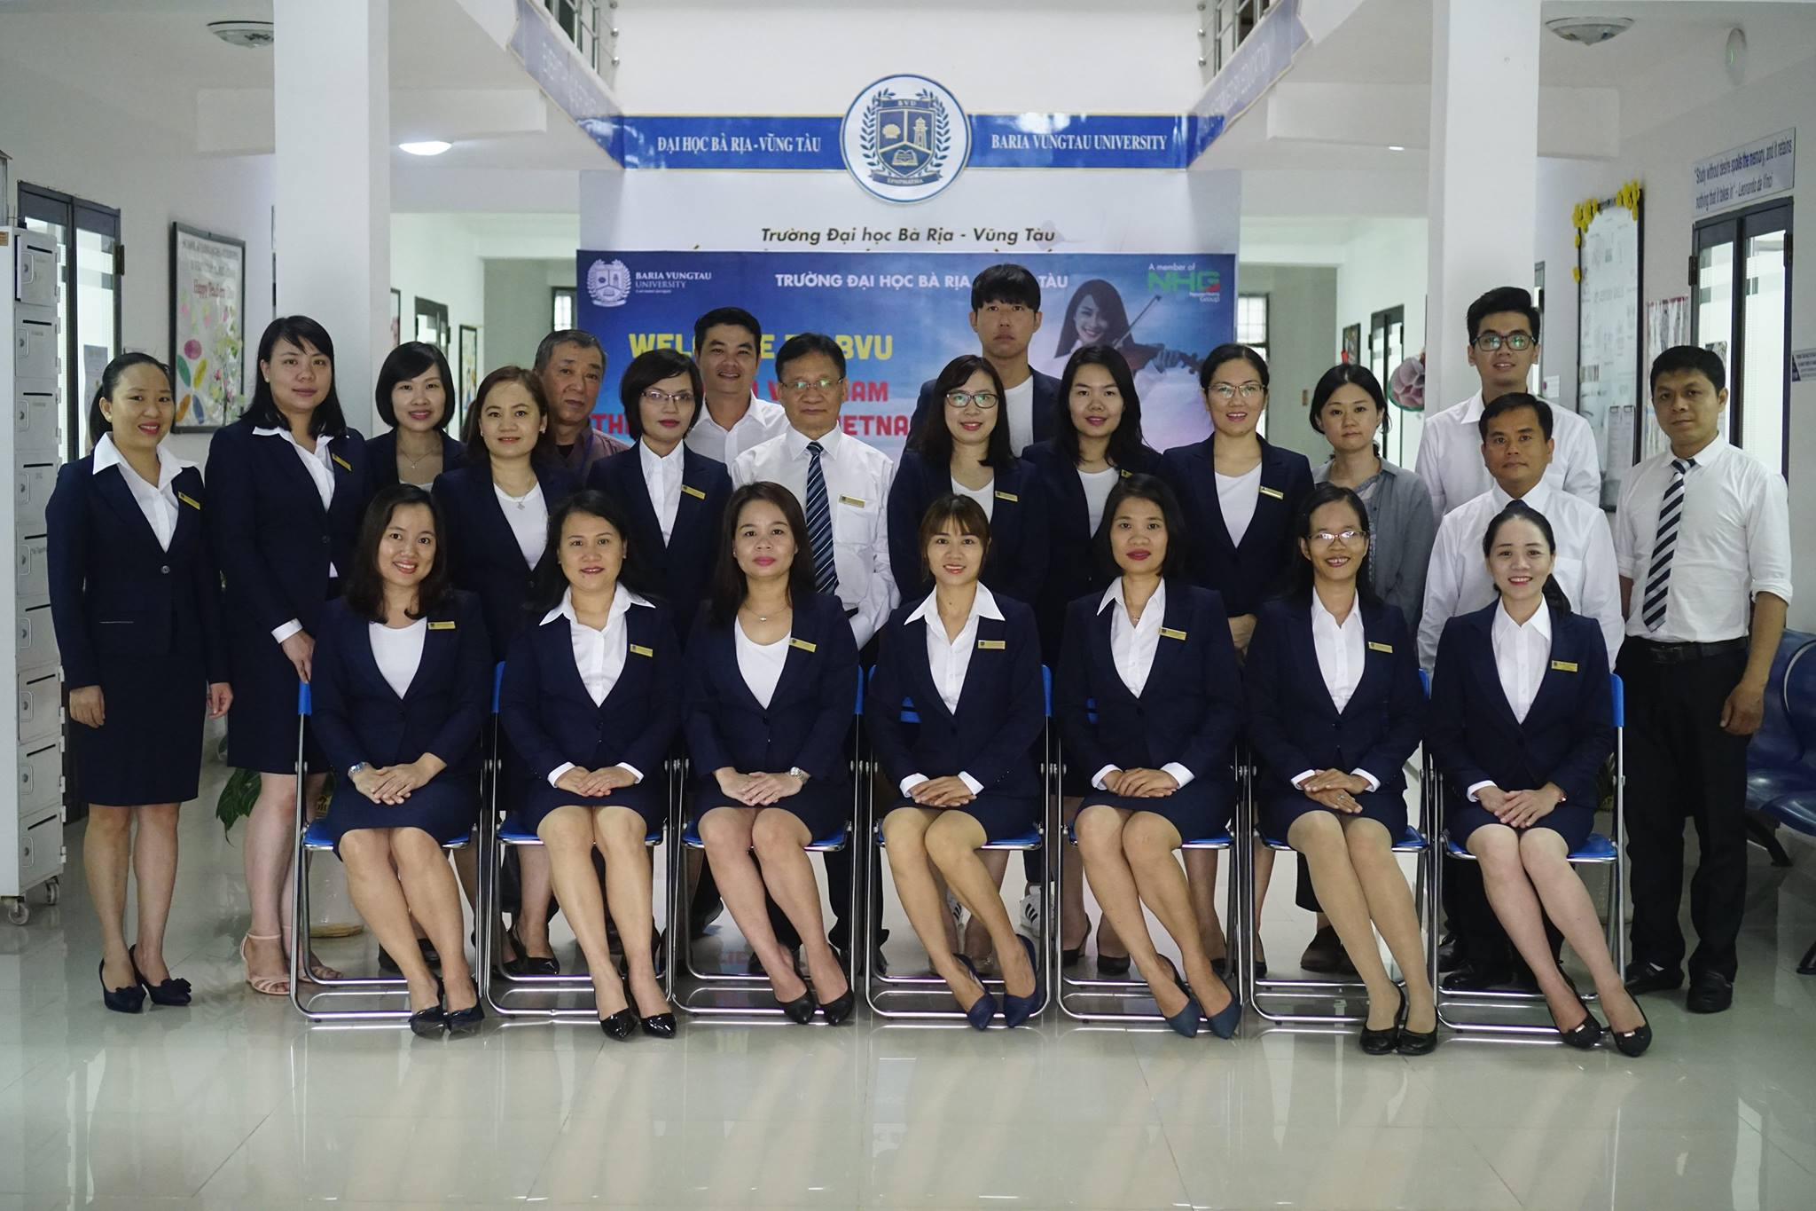

Slide 2
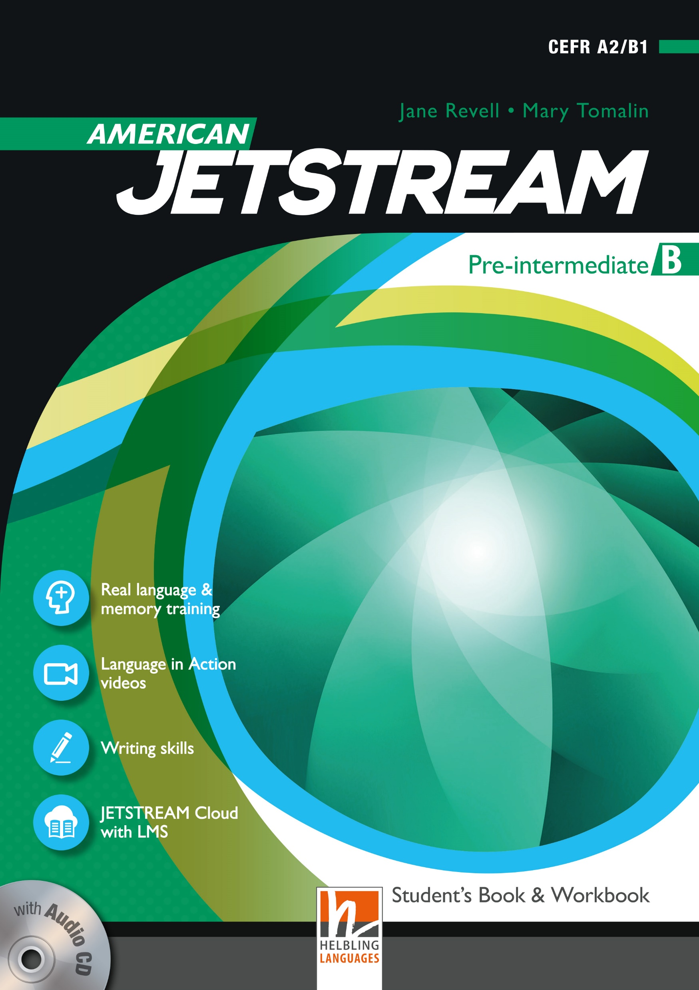
AMERICAN JETSTREAM PRE-INTERMEDIATE B

Slide 3
TEACHER’S PERSONAL INFORMATION
Name: Nguyen Thanh Loan
Facebook: Loan Nguyễn Thanh
Mobile number: 0942 255 937
Email: loannguyenthanh1978@gmail.com

Slide 4
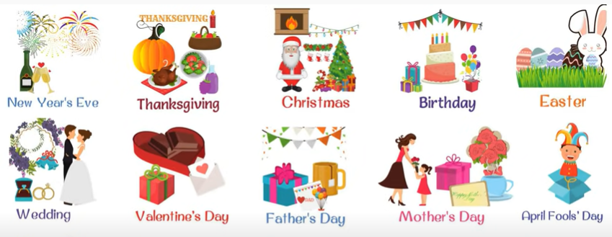
UNIT 12
SPECIAL OCCASIONS
/ˈspeʃl əˈkeɪʒn/
a particular time when something happens

Slide 5
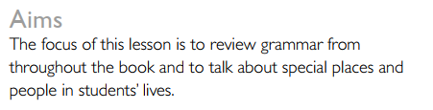
UNIT 12
SPECIAL OCCASIONS
Lesson 3
Reliving an experience

Slide 6
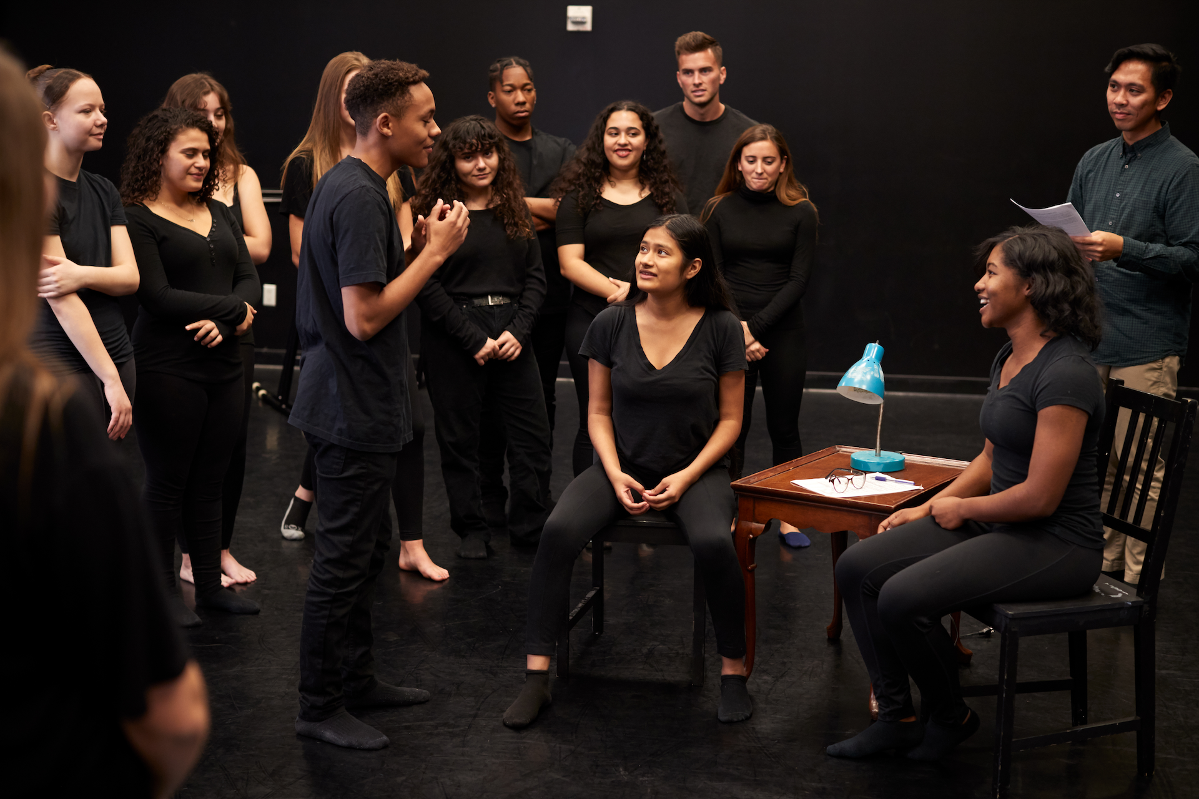
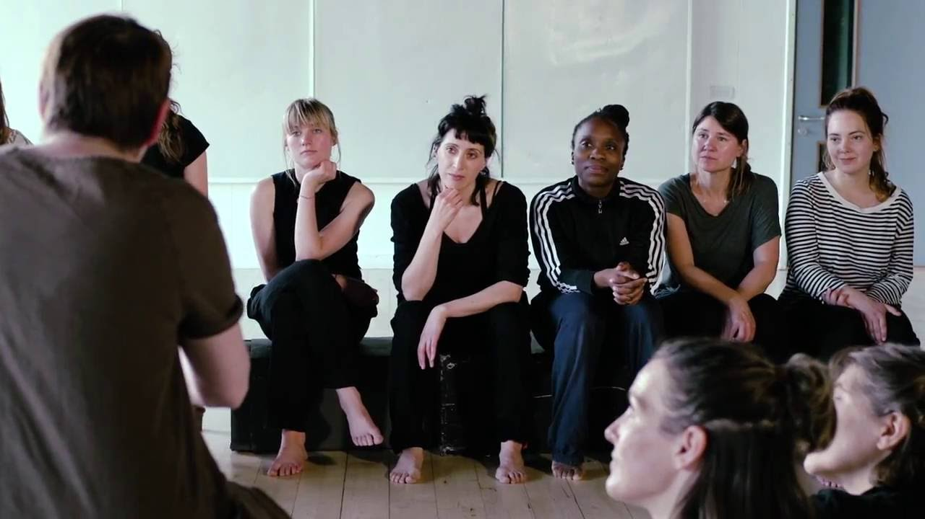
VOCABULARY
Or stage school/theatre school is an undergraduate and/or graduate school or department at a college or university which specializes in the pre-professional training in drama and theatre arts, such as acting, design and technical theatre, arts administration, and related subjects.
Drama school
/ˈdrɑːmə/

Slide 7
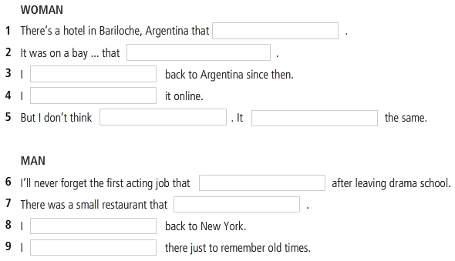

LISTENING 1
Special places
Activity 3 (p. 52)
Listen to two people talking about special places in their lives and complete the sentences.

Slide 8
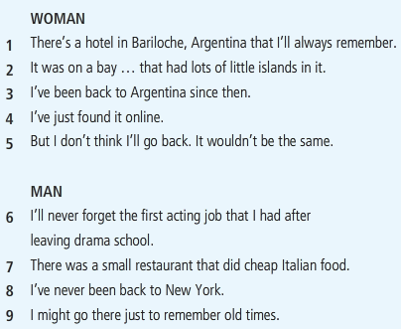
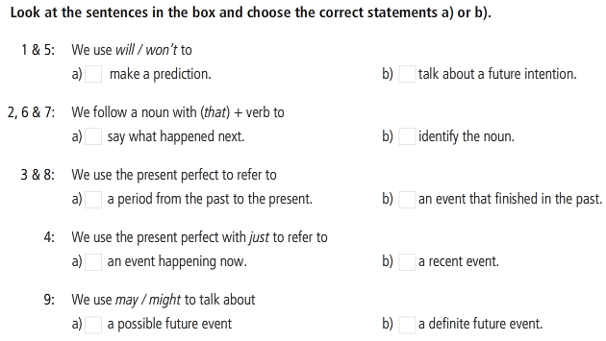





GRAMMAR REVIEW

Slide 9
Grammar review
Special places
1. Will / won’t to____:
Make a prediction
Ex: But I don’t think I’ll go back there.
2. We follow a noun with “that” + verb to____:
Identify the noun
Ex: It was on a lake that had lots of little islands in it.
3. We use the present perfect to refer to____:
A period from the past to the present
Ex: I’ve been back to Argentina since then.
4. We use the present perfect with just to refer to____:
A recent event
Ex: I’ve been back to Argentina since then.
5. We use may/might to talk about_____.
A possible future event
Ex: I might go there just to remember old times.

Slide 10
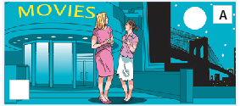
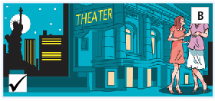
LISTENING 2
Special places
Activity 8 (p. 53)
Listen and match the conversation with the correct picture.
1. What country and city do you think this is?
The US / New York because we can see the Statue of Liberty in picture B.
2. What is the bridge in A?
The Brooklyn bridge in New York.

Slide 11
LISTENING 2
Special places
Activity 9 (p. 53)
Listen again and correct the sentences.
1. Ella is coming to stay for a few days. week
2. Heidi hasn’t seen Ella for four times.
3. Ella and Heidi were bestfriend as school.
4. Ella is arriving in New York on Friday.
5. If Heidi had the times, she’d go to Hongkong to visit Ella.
6. If Jake is free one evening, he’ll go to a baseball game with Heidi and Hella.

Slide 12
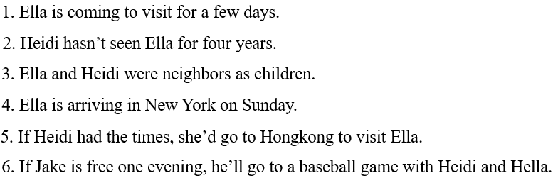
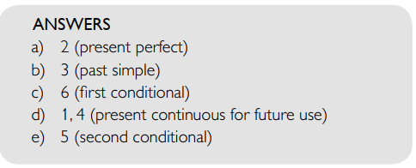
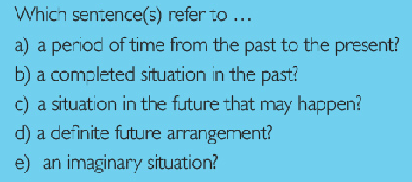
GRAMMAR REVIEW

Slide 13
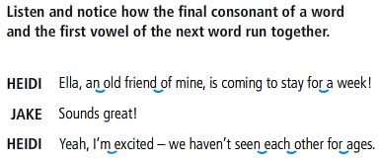
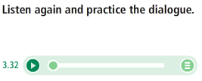
LISTENING 2

Slide 14
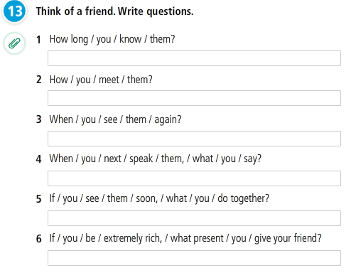
Grammar review

Slide 15
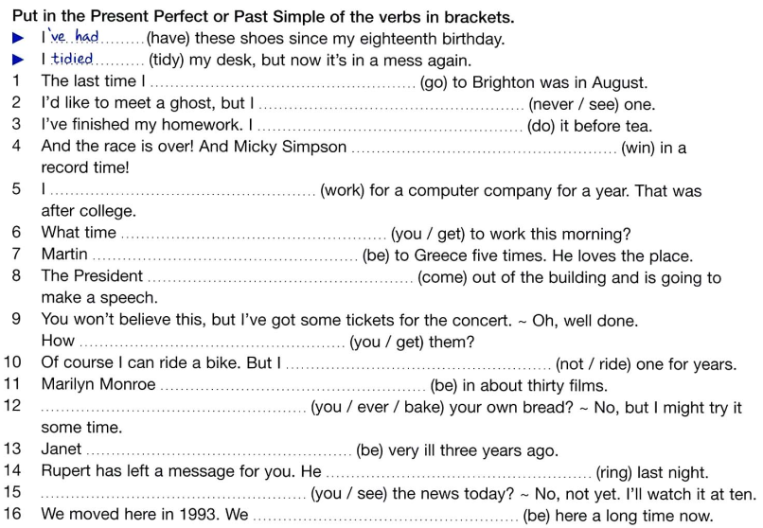
GRAMMAR
REVIEW

Slide 16
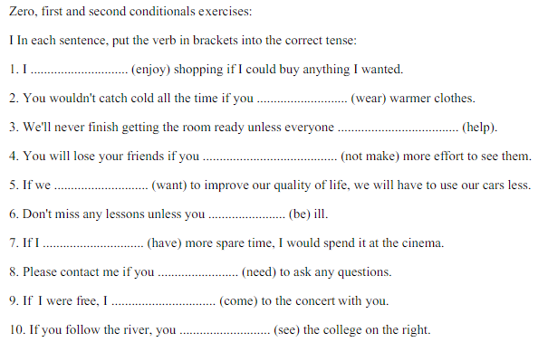
GRAMMAR
REVIEW

Slide 17
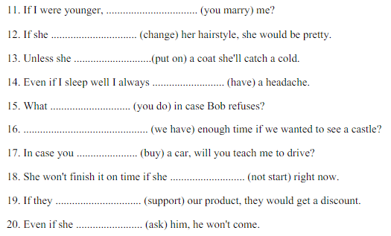
GRAMMAR
REVIEW

Slide 18
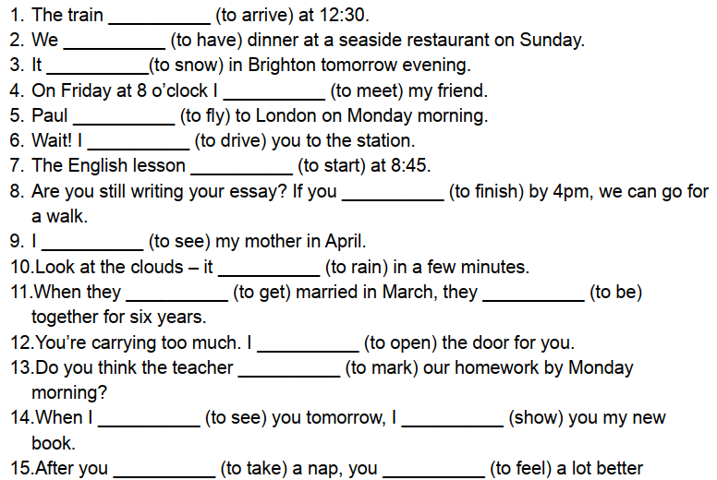
GRAMMAR
REVIEW
Future tense exercises

Slide 19
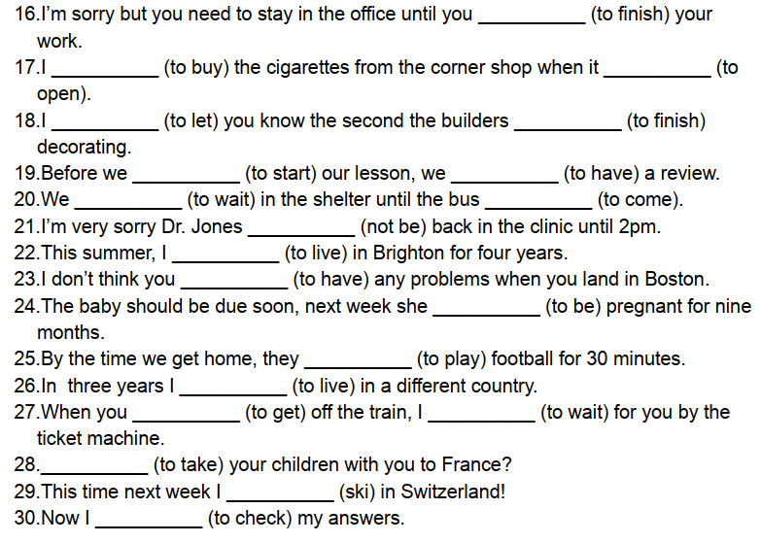
GRAMMAR
REVIEW
Future tense exercises

Slide 20
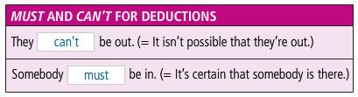

Slide 21
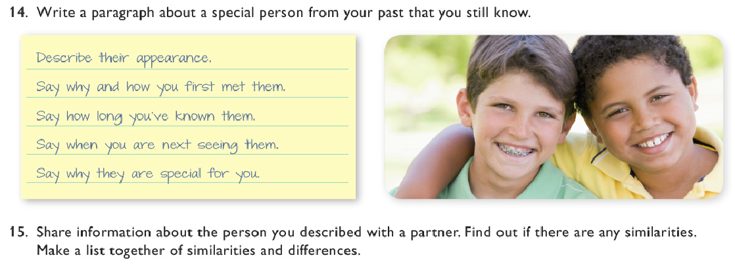
WRITING

Slide 22
REFERENCES
Speaking
https://www.youtube.com/watch?v=kNyzt3JNRzY
Reading
https://www.youtube.com/watch?v=3Sv0ac-W8Vc
Listening
https://www.youtube.com/watch?v=iXfRgzfIx5A
https://www.youtube.com/watch?v=G7P2h_09TVg

